Slide 1


















































LEAD SCORE CASE STUDY
GROUP MEMBERS:
Mukesh Pandiri

Slide 2

































PROBLEM STATEMENT
X Education sells online courses to industry professionals.
X Education gets a lot of leads, its lead conversion rate is very poor. For example, if, say, they acquire 100 leads in a day, only about 30 of them are converted.
To make this process more efficient, the company wishes to identify the most potential leads, also known as ‘Hot Leads’.
If they successfully identify this set of leads, the lead conversion rate should go up as the sales team will now be focusing more on communicating with the potential leads rather than making calls to everyone.
Business Objective:
X education wants to know most promising leads.
For that they want to build a Model which identifies the hot leads. Deployment of the model for the future use.

Slide 3































SOLUTION METHODOLOGY
Check and handle duplicate data.
Check and handle NA values and missing values.
Drop columns, if it contains large amount of missing values and not useful for the analysis.
Imputation of the values, if necessary.
Check and handle outliers in data. EDA
Univariate data analysis: value count, distribution of variable etc.
Bivariate data analysis: correlation coefficients and pattern between the variables etc. Feature Scaling & Dummy Variables and encoding of the data.
Classification technique: logistic regression used for the model making and prediction.
Validation of the model.
Model presentation.

Slide 4
































EDA
Quick check was done on % of null value and we dropped columns with more than 45% missing values.
We also saw that the rows with the null value would cost us a lot of data and they were important columns. So, instead we replaced the NaN values with 'not provided’.
Since India was the most common occurrence among the non-missing values, we imputed all not provided values with India.
Then we saw the Number of Values for India were quite high (nearly 97% of the Data), so this column was dropped.
We also worked on numerical variable, outliers and dummy variables.

Slide 5
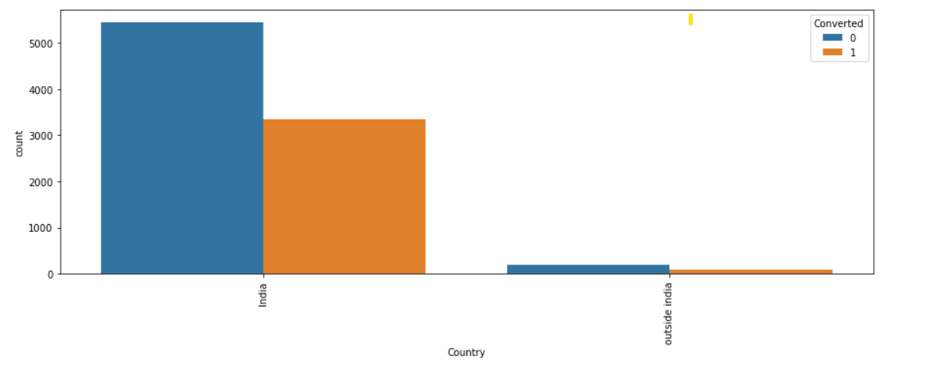
EDA
As we can see the Number of Values for India are quite high (nearly 97% of the Data), this column can be dropped

Slide 6








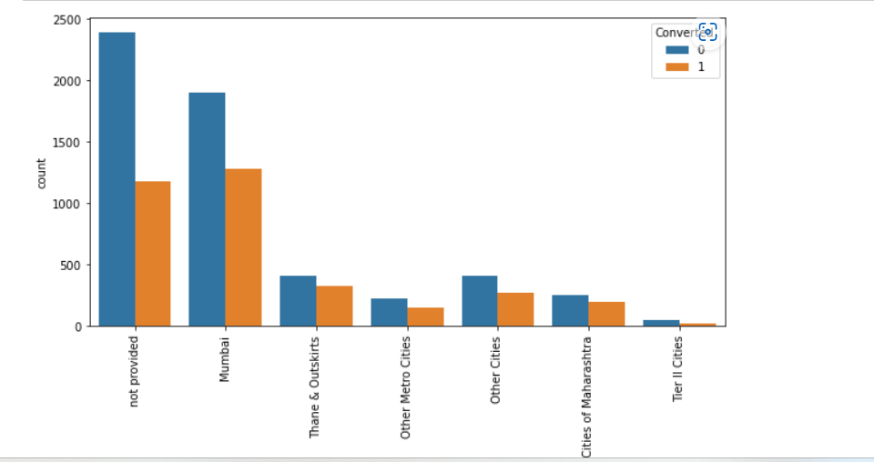























Plotting spread of City columnn

Slide 7









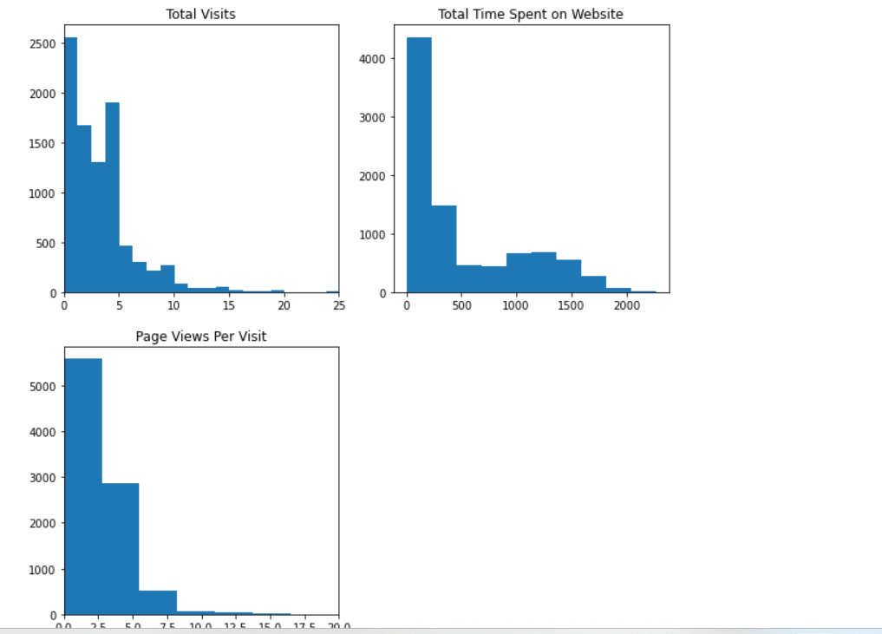





















Numerical Variables

Slide 8
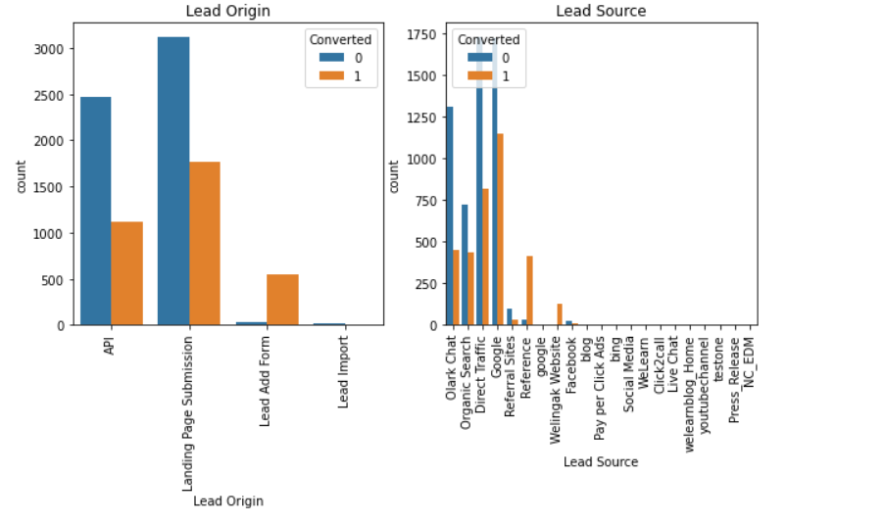
CATEGORICAL VARIABLE RELATION

Slide 9








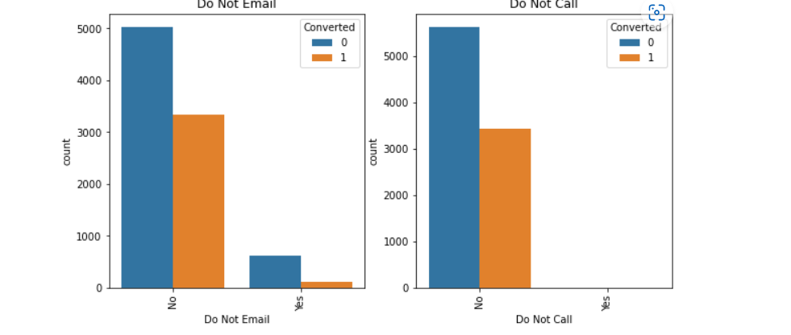





















CATEGORICAL VARIABLE RELATION

Slide 10









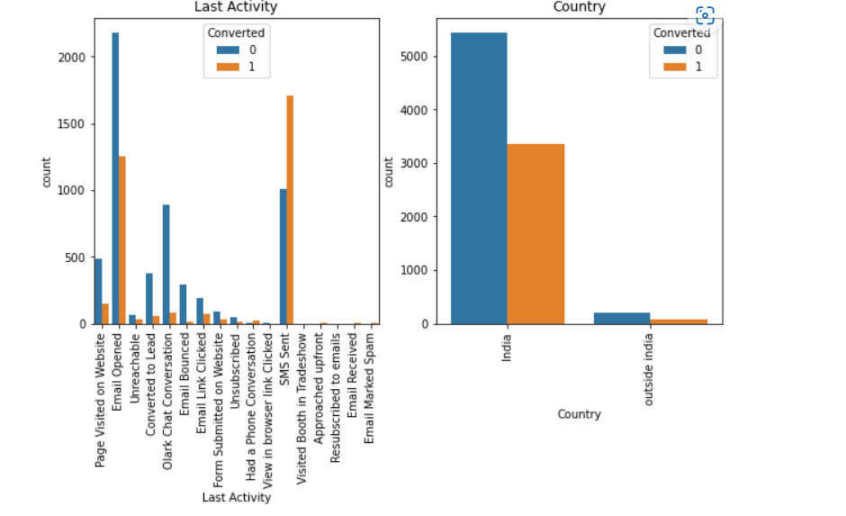























CATEGORICAL VARIABLE RELATION

Slide 11







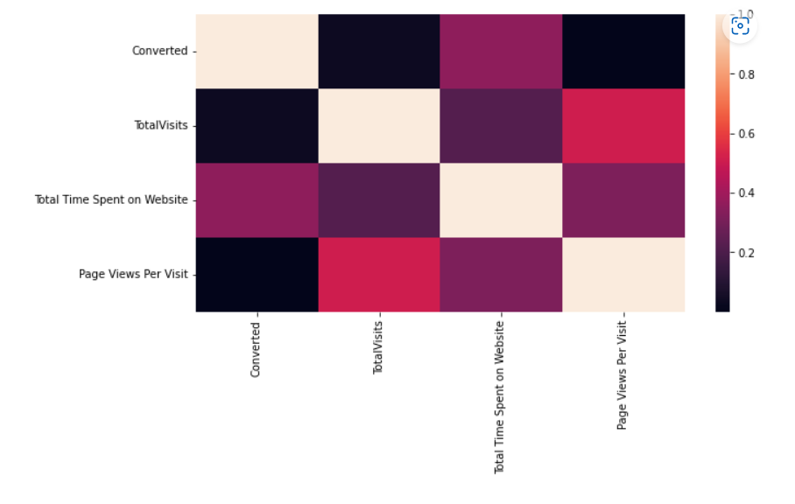























Correlation between Variables

Slide 12






























MODEL BUILDING
Splitting the Data into Training and Testing Sets
The first basic step for regression is performing a train-test split, we have chosen 70:30 ratio.
Use RFE for Feature Selection
Running RFE with 20 variables as output
Building Model by removing the variable whose p- value is greater than 0.05 and vif value is greater than 5
Predictions on test data set Overall accuracy 81%

Slide 13
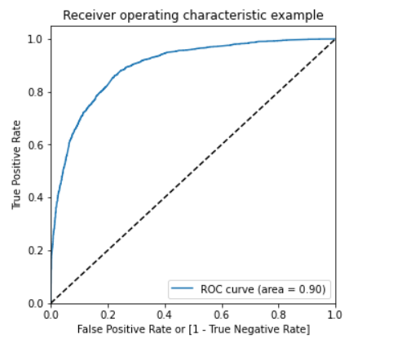
Model Evaluation and ROC curve
With the current cut off as 0.5 we have around 82% accuracy, sensitivity of around 70% and specificity of around 89%.
The area under ROC curve is 0.90 which is a very good value

Slide 14








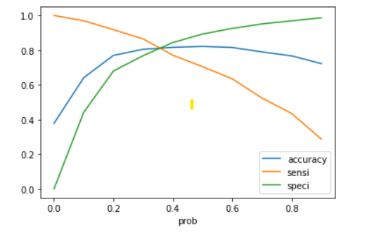




















ROC CURVE-Precision and recall tradeoff
Finding Optimal Cut off Point:
Optimal cut off probability is that probability where we get balanced sensitivity and specificity.
From the second graph it is visible that the optimal cut off is at 0.35.
Overall Accuracy achieved on test data is: 88.03%

Slide 15
































CONCLUSION
It is observed that the variables that mattered the most in the potential buyers are (In descending order) :
TotalVisits
The total time spend on the Website.
Lead Origin_Lead Add Form
Lead Source_Direct Traffic
Lead Source_Google
Lead Source_Welingak Website
Lead Source_Organic Search
Lead Source_Referral Sites
Lead Source_Welingak Website
Do Not Email_Yes
Last Activity_Email Bounced
Last Activity_Olark Chat Conversation
Keeping these in mind the X Education can flourish as they have a very high chance to get almost all the potential buyers to change their mind and buy their courses.

